Slide 1
Learning to Code : Python WEEK 1
Sanu Shameer

Slide 2
Course outline
Build a hide-and-go-seek game
Build a map
Position hider(s)
Seeker seeks and finds hider(s)
Program the seeker
Save/load feature
Program the hiders to run from the seeker
Week 1 – Introduction to coding, python and data types I
Week 2 – Data types II
Week 3 – Condition statements and loops
Week 4 – Read/Write files & Code
Week 5 – Functions
Week 6 – Classes and modules

Slide 3
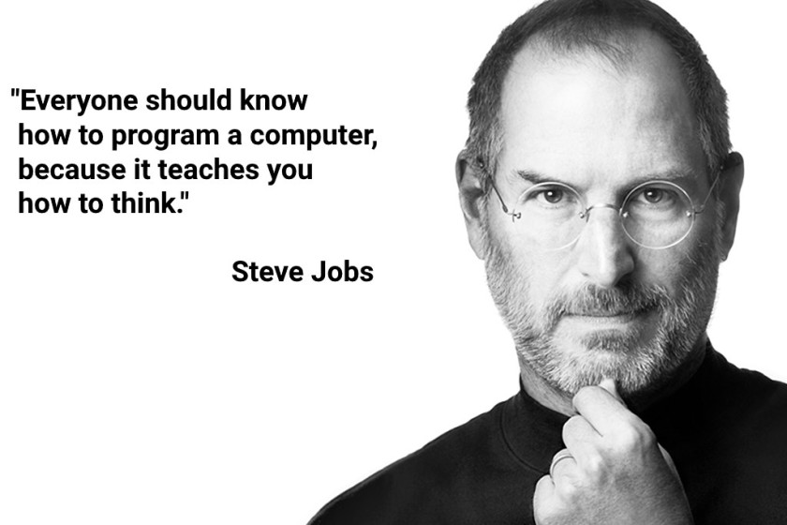
Introduction to coding
Why learn coding?
It a useful skill to have in science, accounts, marketing, engineering….
It is a great way to make money
It teaches you how to most efficiently deal with repetitive tasks
All codes can be broken up into simple steps
If you learn one, you can pick up most other languages on your own

Slide 4

Be logical!!
Image source :
https://sacerdotus.files.wordpress.com/2015/02/7234b-star-trek-spock-salute-sublimated-pillow-case-4.jpg

Slide 5


Introduction to PYTHON
Python is a high level object oriented programming language.
Its is one of the most easiest to learn and is very widely used.
Ex:
Python can be used as environment to perform tasks (as in Matlab or R) or run scripts directly (Java, C++)
public class Script{
public static void main (String[] args){
System.out.println(“Hello”)
}
}
print “Hello”

Slide 6
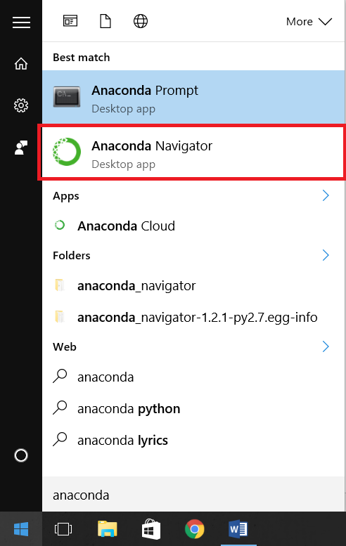
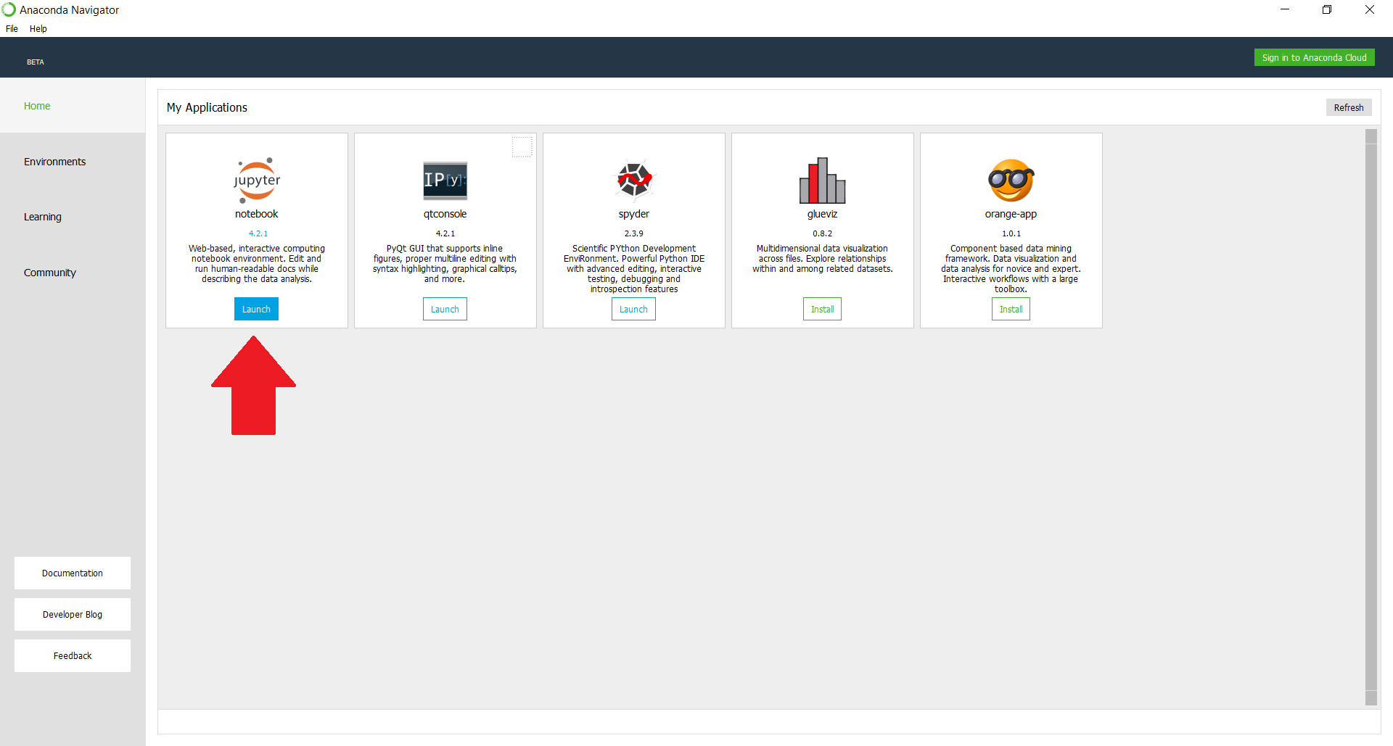
Check PYTHON INSTALLATION : ANACONDA

Slide 7
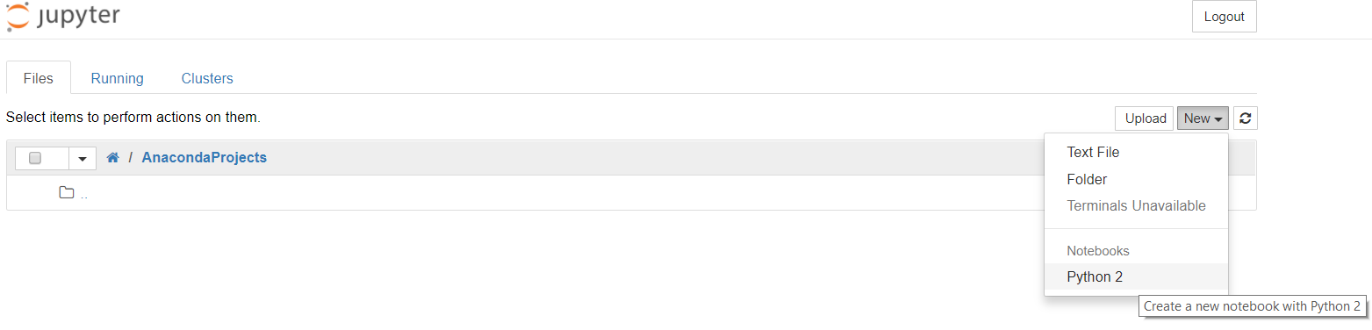
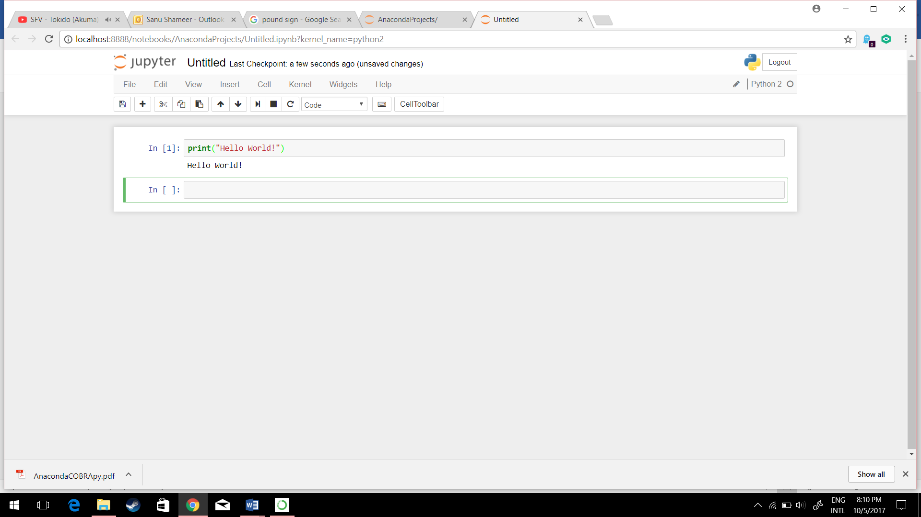
Check PYTHON INSTALLATION : ANACONDA

Slide 8
MEET YOUR BEST FRIEND: THE TEXT EDITOR
Python IDLE
Can test code in the python environment window
Can run scripts directly from editor
Supports only python
Notepad++
Looks just like your windows notepad
Supports multiple programming languages and formats
https://notepad-plus-plus.org/

Slide 9
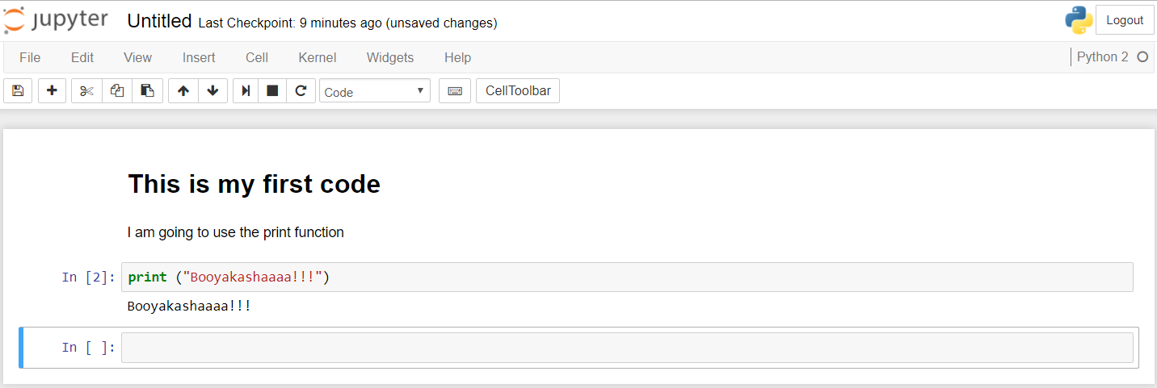
MEET YOUR BEST FRIEND: THE TEXT EDITOR
Anaconda python notebook
Anaconda notebook lets users write scripts and record results
Allows users to test their code and is beginner-friendly
Headings
Plain Text
Script
Result

Slide 10
DATA TYPES in PYTHON
Everything something…
int : Integers
Used to represent whole numbers, ex: 2 , -4, 0
Does not have decimal places
float : Floating-point numbers
Used to represent real numbers, ex: 1.5, -3.9, 0.0
Allows decimal places
str : Strings
Used to represent a character or a sequence of alpha-numeric characters, ex: “Apple3”, “A”, “3”, ””

Slide 11
BASIC OPERATIONs
“=“: assigning a value
“+”: addition or string concatenation
“/”: division
“%”: modulo (remainder from division)
“**”: power
BASIC Functions
print(a) : prints the value of a
int(a) : returns value of a as int
float(a) : returns value of a as float
str(a) : returns value of a as string
type(a) : returns the data type a falls under
dir(a) : returns built-in properties of a

Slide 12
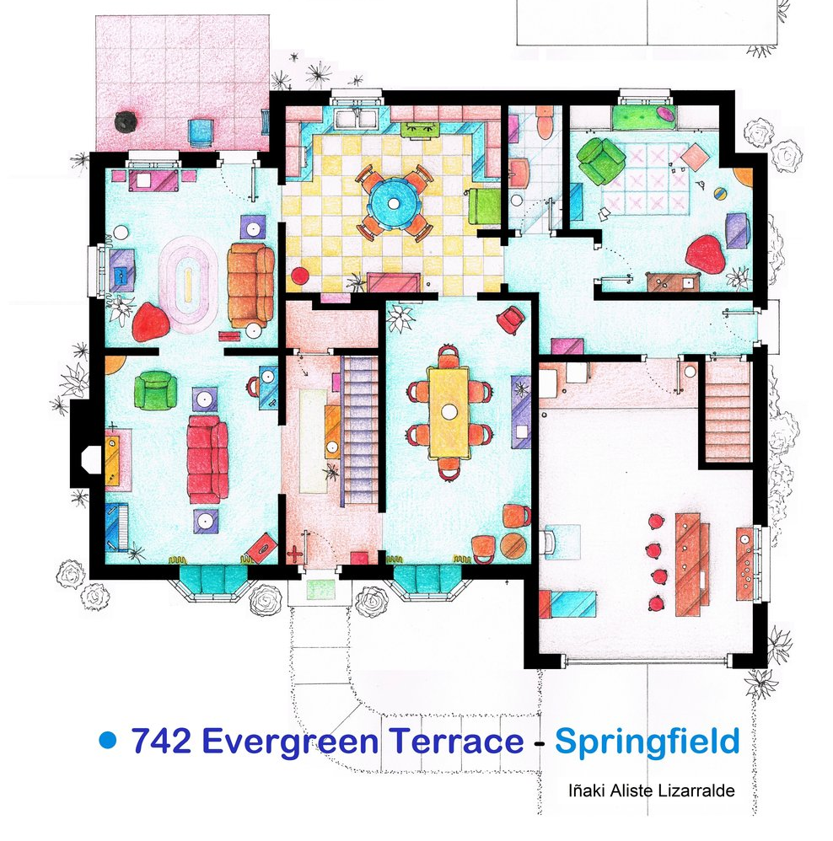
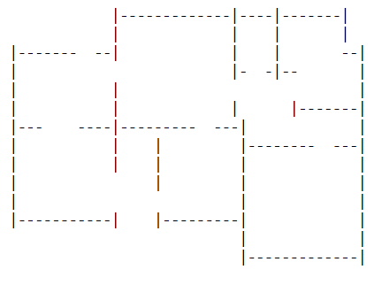
EXERCISE : Week 1
Objective: Create a map for your hide-and-go-seek game

